Slide 1
Chapter 6: Sensors, Actuators, and Microcontrollers
IOT CƠ BẢN
502068

Slide 2
Ghi chú về bản quyền
Toàn bộ nội dung bài giảng là của CISCO, sinh viên có quyền tải về, lưu trữ, in ấn, tham khảo cho mục đích học tập. Sinh viên không được phát hành lại hay thay đổi nội dung slide nếu chưa có sự đồng ý của chủ sở hữu.
Phần ghi chú ở cuối slide (nếu có) là do các thầy cô ghi chú lại trong quá trình giảng dạy.

Slide 3
Chapter 2: Sensors, Actuators, and Microcontrollers
IoT Fundamentals
Connecting Things 2.01
Notes:
Cisco Networking Academy Program
Connecting Things
Chapter 2: Things and Connections

Slide 4
Chapter 2 - Sections & Objectives
2.1 Learn Electronics
Explain how components and devices are used to build and measure values in electronic circuits.
2.2 Microcontrollers: The SparkFun Inventor’s Kit
Create circuits and microcontroller programs with the Arduino and a variety of components.
2.3 Packet Tracer 7.0 and the IoT
Explain how Packet Tracer models IoT systems.
Notes:
3

Slide 5
2.1 Learn Electronics
Notes:
Cisco Networking Academy Program
Connecting Things
Chapter 2: Sensors, Actuators, and Microcontrollers

Slide 6
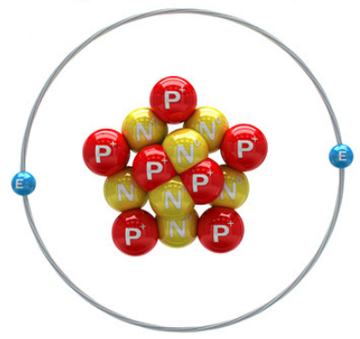
Learn Electronics 2.1.1 Basic Electronic Terminology & Concepts
What is Electronics?
Electronics is the field of study focused on the control of electricity and the physical components and circuits that help direct electrical energy.
Definitions
Terms commonly used in electronics include:
Electrons, atoms, and chemical elements
Electric current
Electrical conductors, insulators, and circuits
Voltage, Amperes (amps), and Power
Notes:
2.1 – Learn Electronics
2.1.1 – Basic Electronics Terminology and Concepts

Slide 7
Learn Electronics Basic Electronic Terminology / Concepts (cont’d)
Ohm’s Law
Ohm’s Law states that within a circuit, voltage (V) is directly proportional to the strength of current (I) multiplied by resistance (R).
Resistance is measured in ohms (Ω)
Basic Circuit
An electrical circuit is a closed conductive path that allows electrons to flow and create an electric current.
A circuit also needs an electrical energy source like a battery to start the flow of electricity.
V = I ͯ R
R = V / I
I = V / R
Notes:
2.1 – Learn Electronics
2.1.1 – Basic Electronics Terminology and Concepts

Slide 8
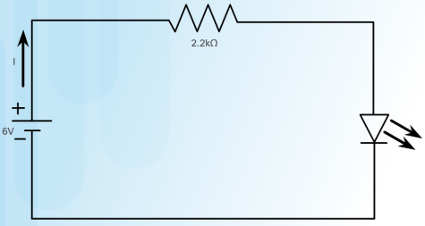
Learn Electronics Basic Electronic Terminology / Concepts (cont’d)
Basic Circuit (Cont.)
The following circuit diagram (schematic) consists of:
6 volt (V) battery provides current
2.2 kΩ resistor (protects the LED from receiving too much current and being destroyed)
A light-emitting diode (LED)
Current (I) flows from the positive terminal to the negative terminal
Resistance is measured in ohms (Ω).
The triangular part represents a diode and the two arrows facing out represent the fact that this diode emits light.
Notes:
2.1 – Learn Electronics
2.1.1 – Basic Electronics Terminology and Concepts

Slide 9
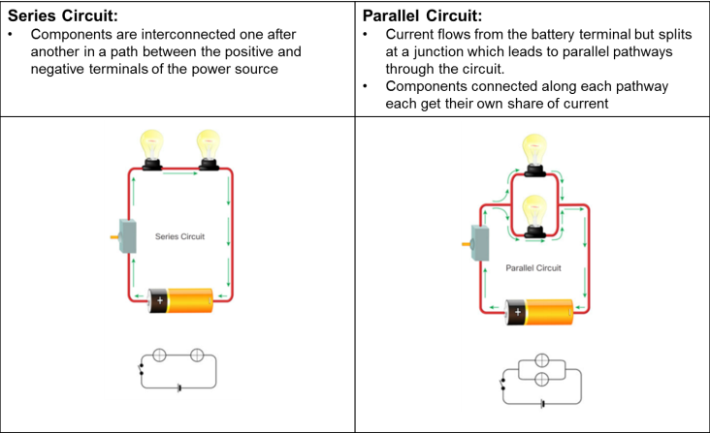
Learn Electronics 2.1.2 Advanced Electronic Terminology /Concepts
Series and Parallel Circuits
Notes:
2.1 – Learn Electronics
2.1.2 – Advanced Electronic Terminology and Concepts

Slide 10
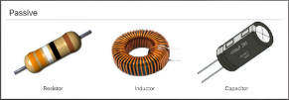
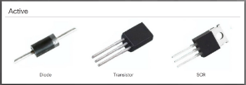
Learn Electronics Advanced Electronic Terminology/Concepts (cont’d)
Passive, Active, Linear, and Nonlinear Circuits
Active circuits contain active components; components that rely on external power source to control current flow.
Passive circuits contain passive components; components incapable of controlling current flow.
Analog circuits are circuits where the signal is contiguous.
Direct Current vs. Alternating Current
In DC current, electron flow is only in one direction.
Batteries, power supplies, thermocouples, solar cells, or dynamos generate DC.
In AC current, electron flow periodically reverses direction.
Hydroelectric plants generate AC.
Notes:
2.1 – Learn Electronics
2.1.2 – Advanced Electronic Terminology and Concepts

Slide 11


Learn Electronics Advanced Electronic Terminology/Concepts (cont’d)
Analog Circuits vs. Digital Circuits
Analog Circuits: Circuits in which signals vary continuously with time.
Digital circuits: Circuits in which signals that take one of two discrete values.
Components
Electronic components are specialized devices used in a circuit to control current.
Components have two or more electrical terminals (leads) that enable them to connect to an electronic circuit.
Larger Electronic Building Blocks
Solenoids can be used to electrically open door latches, open or shut valves, move robotic limbs, and even actuate electric switch mechanisms.
Relays allow for controlling a large amount of current and/or voltage with a small electrical signal.
Notes:
2.1 – Learn Electronics
2.1.2 – Advanced Electronic Terminology and Concepts

Slide 12
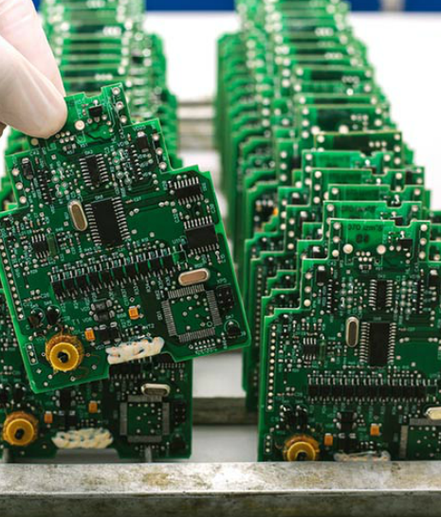
Learn Electronics 2.1.3 From Schematic Diagram to Breadboard to Soldered PCB
Design Phase:
Consists of three steps: Concept, Research, Circuit Design.
A circuit diagram shows the components and interconnections of the circuit using standardized symbolic representations.
Prototype Phase:
Consists of four steps: Hardware, Mechanical, and Software Development, PCB layout, Build prototypes, Product Testing
A solderless breadboard is a tool commonly used in electronic prototyping.
Production Phase:
Consists of three steps: Production Readiness Review, Production, On-going Maintenance.
Often employ on printed circuit boards (PCBs).
Design Phase
Prototype Phase
Production Phase
Notes:
2.1 – Learn Electronics
2.1.3 – From Schematic Diagram to Breadboard to Soldered PCB

Slide 13
2.2 Microcontrollers: The SparkFun Inventors Kit
Notes:
Cisco Networking Academy Program
Connecting Things
Chapter 2: Sensors, Actuators, and Microcontrollers

Slide 14
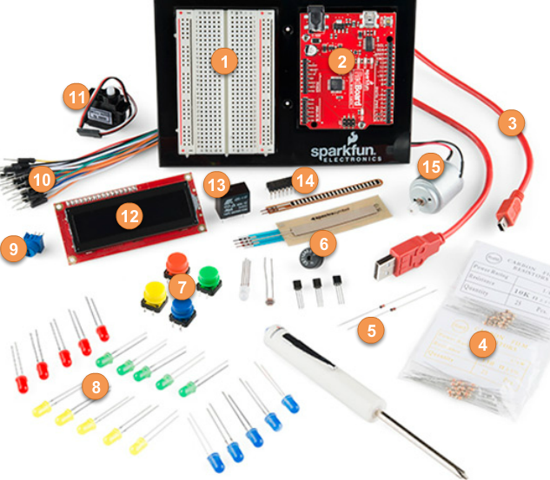
Microcontrollers: The SparkFun Inventors Kit 2.2.1 Introducing the Kit
Introduction to the SparkFun Inventor’s Kit (SIK)
This is a starter kit for building circuits and includes:
Solderless breadboard
SparkFun RedBoard (Arduino-like board)
Various resistors, diodes, LEDs, sensors and actuators
Connecting wires (jumper wires, mini-B cable, …)
Arduino Microcontroller
The Arduino is a popular microcontroller for prototyping.
Instructions for the Arduino are programmed using the Arduino integrated development environment (IDE).
The SparkFun RedBoard is an Arduino-like board that can be programmed using Arduino IDE.
Notes:
2.2 – Microcontrollers: The SparkFun Inventors Kit
2.2.1 – Introducing the Kit

Slide 15
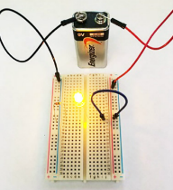
Microcontrollers: The SparkFun Inventors Kit 2.2.2 Simple Circuits
Building a Circuit
A simple circuit can be created by:
Connecting electronic components (LED, resistor, and jumper wires) in series along a row on the breadboard.
Connecting the power source to the lower red and black jumper wires.
This should complete the circuit and light the LED.
The Arduino IDE
Free, downloadable software used to interact with the Arduino board.
Writing code
Programs written using the Arduino IDE are called sketches and are saved with the file extension of .ino.
Arduino sketch keywords can be divided in three main category types: structures, values (variables and constants), and functions.
Keywords used include void, setup(), loop() function, and more.
Notes:
2.2 – Microcontrollers: The SparkFun Inventors Kit
2.2.2 – Simple Circuits

Slide 16
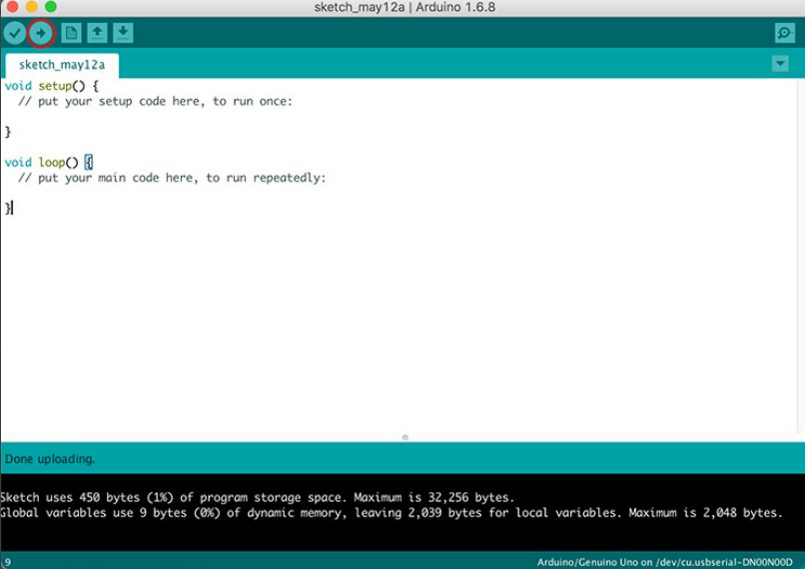
Microcontrollers: The SparkFun Inventors Kit Simple Circuits (cont’d)
Testing
To test and verify the sketch code, click on the checkmark toolbar icon.
The IDE compiles the code and checks for syntax errors.
To upload the sketch to the Arduino and test the code, click on the second toolbar icon (⇨)
Notes:
2.2 – Microcontrollers: The SparkFun Inventors Kit
2.2.2 – Simple Circuits

Slide 17
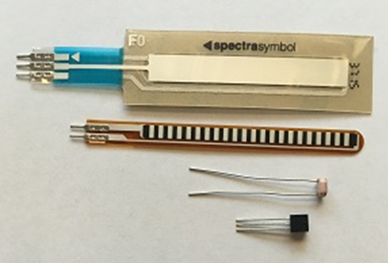
Microcontrollers: The SparkFun Inventors Kit 2.2.3 Sensing the Environment
Sensors
Devices that detect an event from the physical environment and respond with electrical or optical signals as output.
The SIK contains various sensors including Soft potentiometer, Flex sensor, Photo resistor and Temperature sensor.
Notes:
2.2 – Microcontrollers: The SparkFun Inventors Kit
2.2.3 – Sensing the Environment

Slide 18
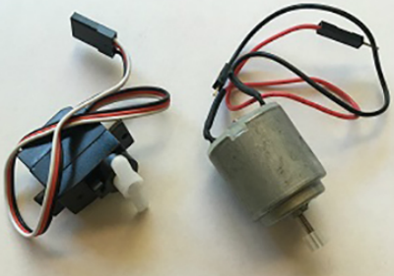
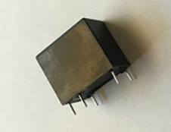
Microcontrollers: The SparkFun Inventors Kit 2.2.4 Making it Happen
Actuators and Relays
An actuator is a type of motor that is responsible for creating movement.
The SIK includes two types of electric actuators that convert electrical energy into mechanical torque.
A relay is an electrically controlled mechanical switch.
The SIK includes a plastic box that contains an electromagnet that causes a switch to trip when it receives a current.
Notes:
2.2 – Microcontrollers: The SparkFun Inventors Kit
2.2.3 – Sensing the Environment

Slide 19
2.3 Packet Tracer 7.x and the IoT
Notes:
Cisco Networking Academy Program
Connecting Things
Chapter 2: Sensors, Actuators, and Microcontrollers

Slide 20
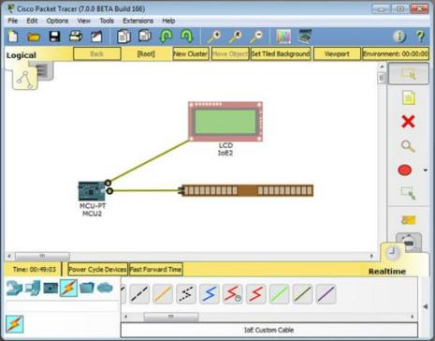
Packet Tracer 7.x and the IoT PT 7.x – End-to-End IoT System Model
How Everything Connects in PT
Packet Tracer 7.x can be used as a prototyping tool.
There is a new group icon contained in Packet Tracer version 7.1 that is labeled Components.
The PT IoT boards contains an MCU and a SBC.
The MCU and SBC are similar to an Arduino and a Raspberry Pi, respectively.
There are also actuators and sensors that can be used in prototypes.
The IoE Custom Cable found in the Connections group can be used to connect IoT things to an MCU board.
Notes:
2.2 – Microcontrollers: The SparkFun Inventors Kit
2.2.4 – PT 7.x – End-to-End IoT System Model

Slide 21
2.4 Chapter Summary
Notes:
Cisco Networking Academy Program
Connecting Things
Chapter 2: Things and Connections

Slide 22
Chapter Summary Summary
Electronics is an important part of the IoT.
IoT devices are often built from scratch; therefore, understanding electronics concepts, components and terminology is critical. It is also important for an IoT professional to be able to read and create electronics schematics.
The SparkFun kit contains a number of devices and parts to help a beginner to get started with electronics and microcontrollers. It also introduces important concepts such as electronic circuits and how to program Arduino microcontrollers. Working with the kit, a beginner can also learn how to program sensors to monitor the environment. Actuators and relays are often used to influence the environment or create action.
Students can use Cisco Packet Tracer 7.x as a tool for modeling and prototyping IoT systems.

Slide 23


Slide 24


